Slide 1
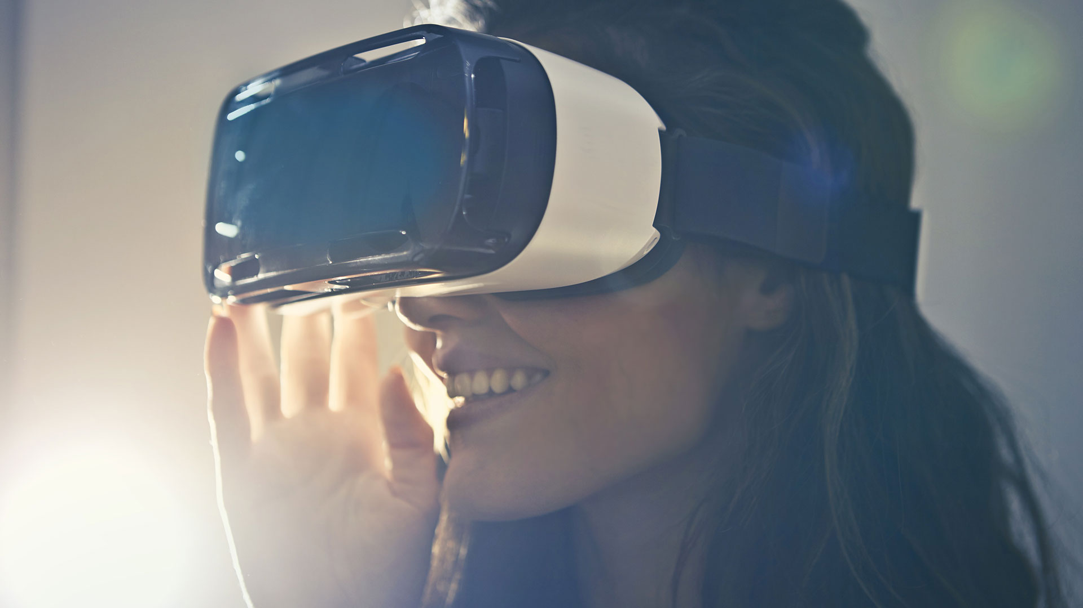
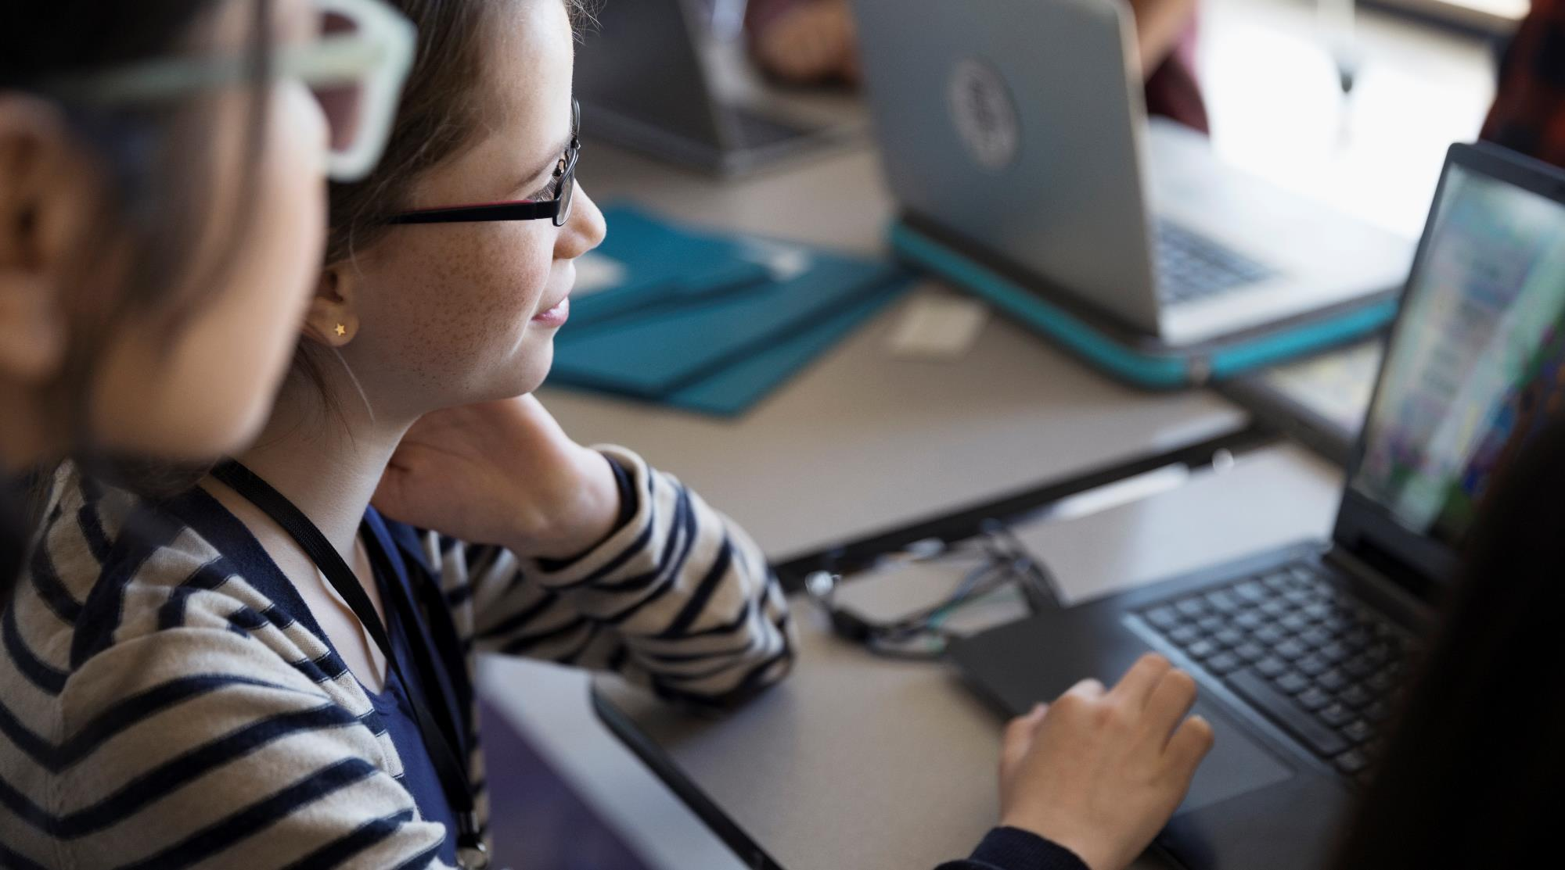
A Friend In Sight Embedded System – Mini Project
Group Number :- 05
Department Of Computer Science & Informatics
Uva Wellassa University Of Sri Lanka

Slide 2

Introduction
Our project is a small robot like system which is going to help the blind or visually impaired people.

Slide 3
Project Description
In human body the most important organ is eyes because eyes are the main sensors that help us to feel the environment.
They cannot live their own life as like as other people but we should accept they also human beings and they also have feelings.
Blind peoples faces so many struggles in their life because of their inability.
In some countries this kind of peoples using guide dogs for their daily life routines, but their also some problems in fact dogs are red and green blinded and also they cannot read things check prices and other things.
These are the main reasons for we have planned to create this system.

Slide 4
Problems
The main problem of the person who is a blind one is walking through the road.
To overcome this problem, our system will be trained to navigate various obstacles and situations, (like if there is a steps or a pit on the ground or water or oil on the ground our system should alert the user), and also our system should be trained to interpreting street signs and street lights also.
Now a days blind people are using white cane and guide dogs for walking through the road.
The main problem of this method is dogs are red and green blinded so they can't see the road signal lights, so we can't train the dogs for the signal system, in our project we are going to train AI to identify the road signs.
This system is not only going to be a navigator but also it should be help in other works.

Slide 5
Solutions for problems
When the user tries to buy something in market system should ensure the product's expiry date and price by reading the bar code on the product label.
Also, the user cannot understand the weather conditions and without eyes he can't understand day and night time differs so the system should be able to give weather alerts (like if the weather is likely to rainy give alert to bring an umbrella) and give date time information.
Basically, blind people find the destination in their house using remember how many steps he or she used to walk usually.
So, In this system which we are planning to Implement we will add a distant measuring system and before a user start to use the system, we will get the input that how many steps a user walks to arrive a particular distance and auto-calculate the steps count and instruct the user.

Slide 6
Methodology
For obstacle finding we need ultrasonic sensor – HC – SR04 (generic)
For street light detecting we need Pi camera
For find if the floor is wet we need DHT11 temperature and humidity sensor (3 pins) and seed studio grove water sensor.
For calculating distance we need ultrasonic sensors.
For currency counting we need to use IR Sensor. TCS230 color sensor.

Slide 7
Hardware Requirements
Raspberry Pi 4
Arduino UNO
GSM Module
Speaker
Mic
12V, 5V DC Adopter
POT
Connecting wires
Breadboard
ICStation Mega 2560
Espressif ESP8266 ESP-01
Buzzer
Servos
DC motor
Jumper wire
SparkFun Dual H-Bridge motor drivers L298

Slide 8

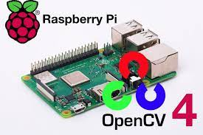


Software Requirements
Open CV 4
Python 3
Tensor flow
Arduino IDE

Slide 9
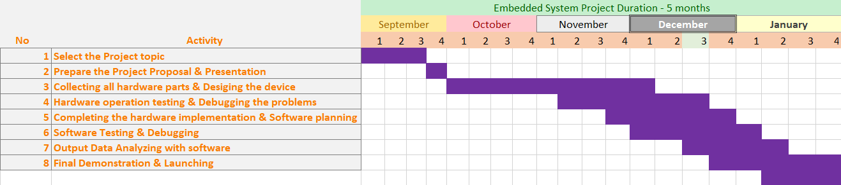
Project Timeline

Slide 10





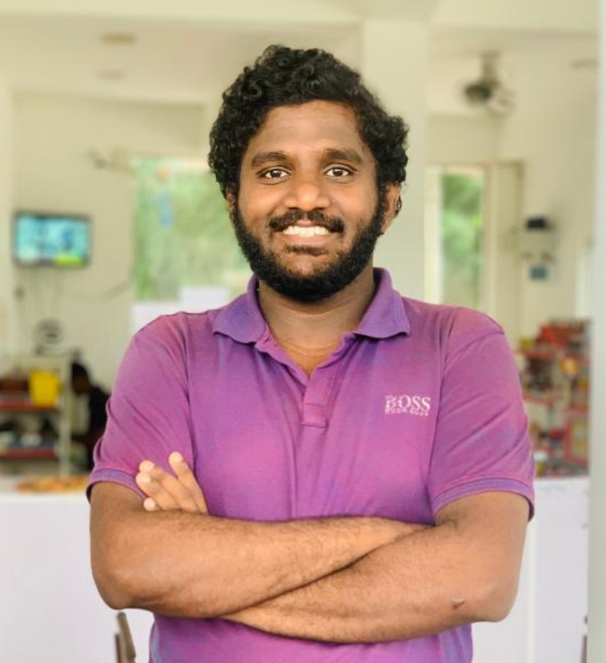
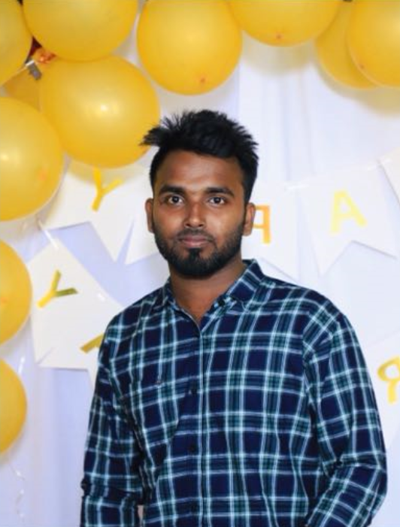
Team Members
V.Thanujan
S.Naksala
T.M.Godakumbura
CST/19/014
CST/19/003
CST/19/054
T.V.T.I.Vithanage
S.Thanusayan
CST/19/029
CST/19/049

Slide 11

Thank You

